Slide 1
Test Automation Framework

Slide 2
Automation Stack
Jira – Software development tool
Test Rail - Test case management
Github - Code repository
Selenium - Automates browsers. Implemented Page Object model that maps pages to the UI to reduce duplicity, improve readability, and ease maintainability
Java - Programming language
TestNG - Test framework for parallel test execution with flexible configurations
Jenkins - Continuous integration. Stores build history, logs, test results, reports, artifacts. Sends email notifications along with build artifacts.
Maven - Build deployment
Slack - Real-time messaging
Sauce Labs - Cloud service provides parallel test runs with multiple platform/browser/version configurations. Saves steps, screenshots, and screencasts
Jmeter - API and load testing
Log4J - logging

Slide 3
Benefits
Maximize efficiency
Increase productivity
Reduce costs

Slide 4
How?

Slide 5
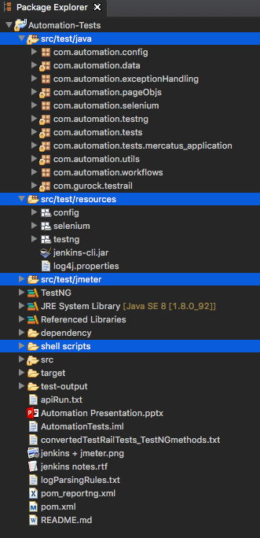
Java Project

Slide 6
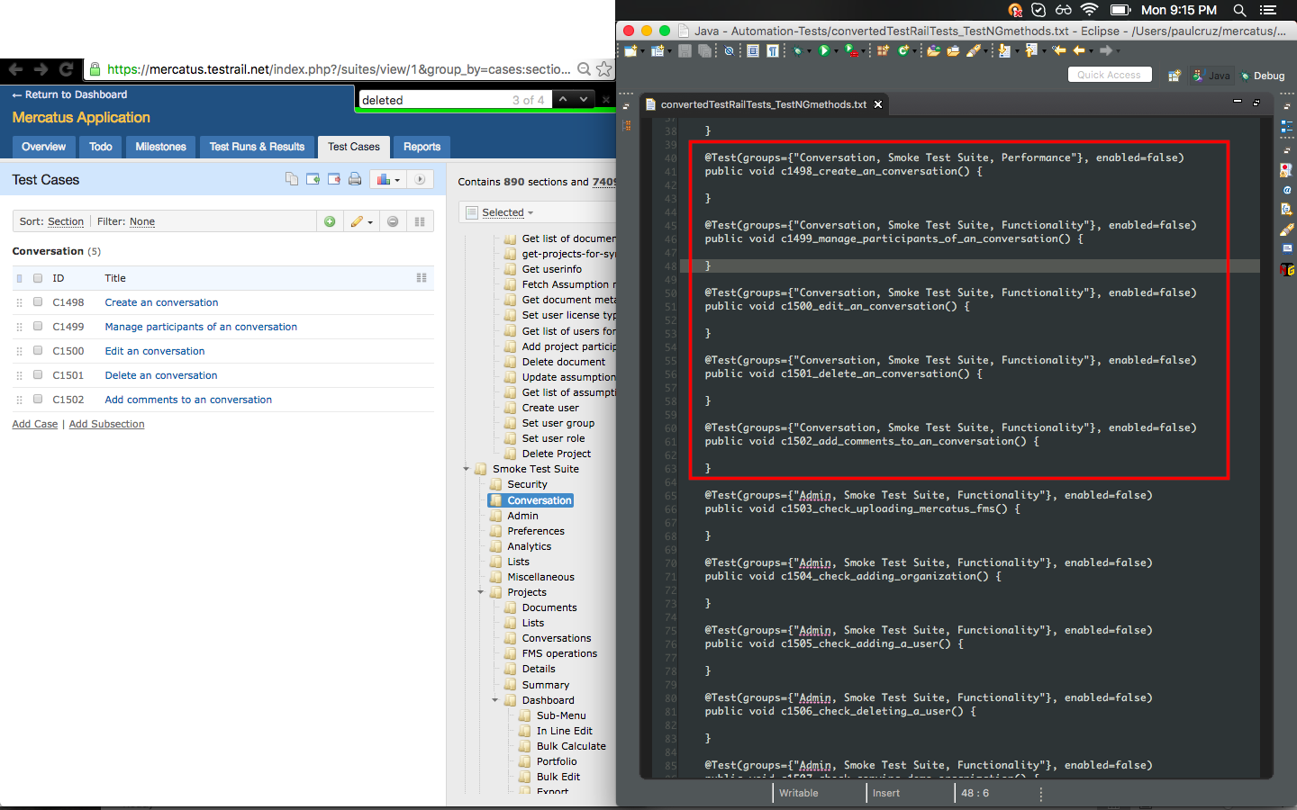
Convert TestRail test cases to TestNG methods

Slide 7
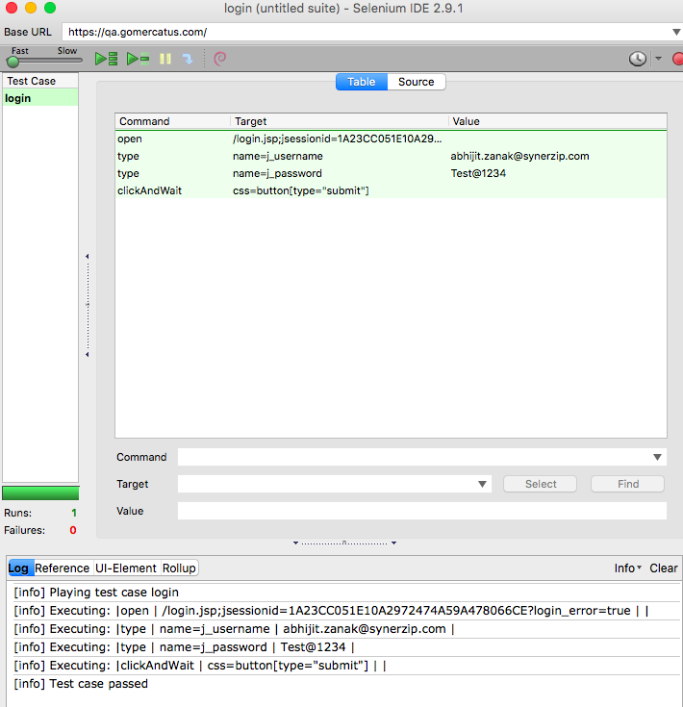
Selenium IDE to help record objects

Slide 8
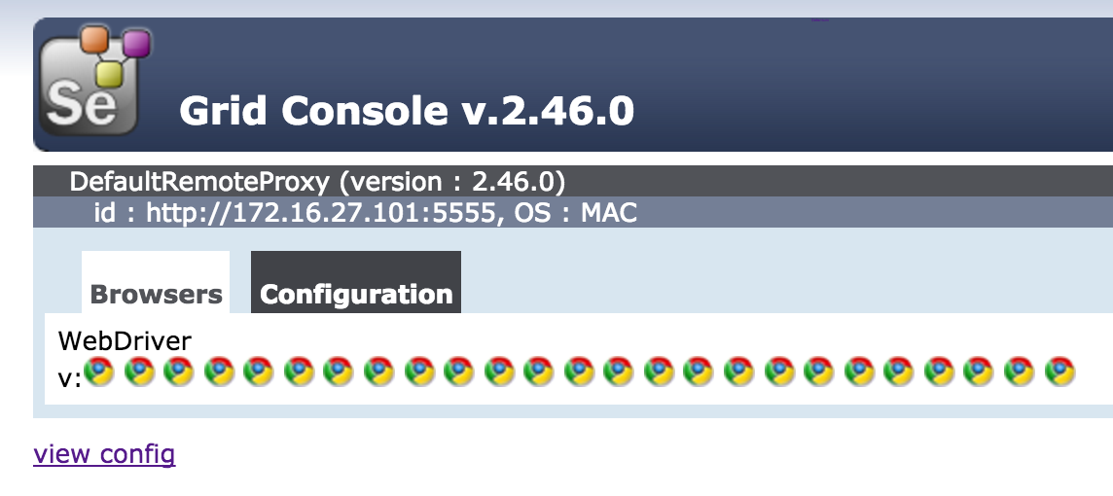
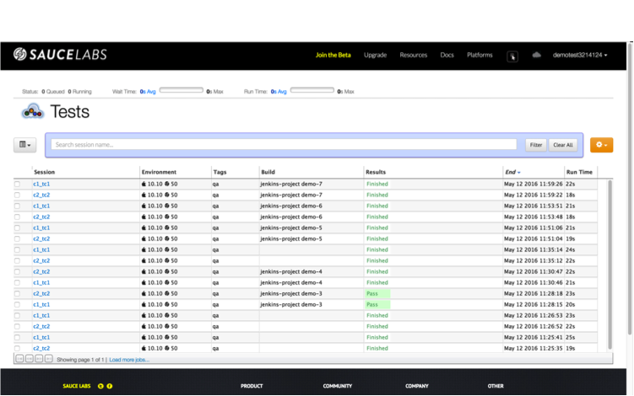
Run where?
Run tests locally on the Selenium Grid when writing/debugging tests
Run tests in the cloud on Sauce Labs when a build is deployed

Slide 9
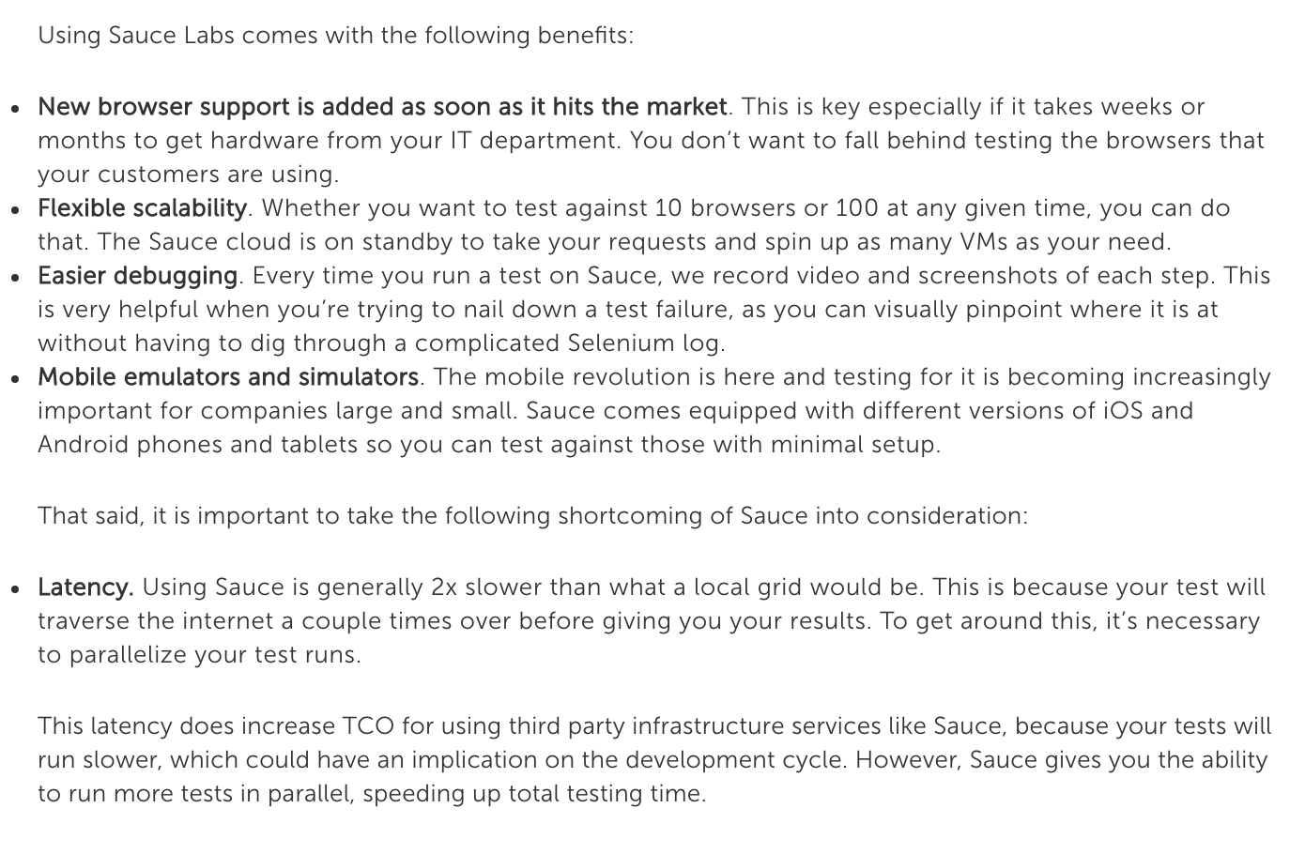
Sauce Labs

Slide 10
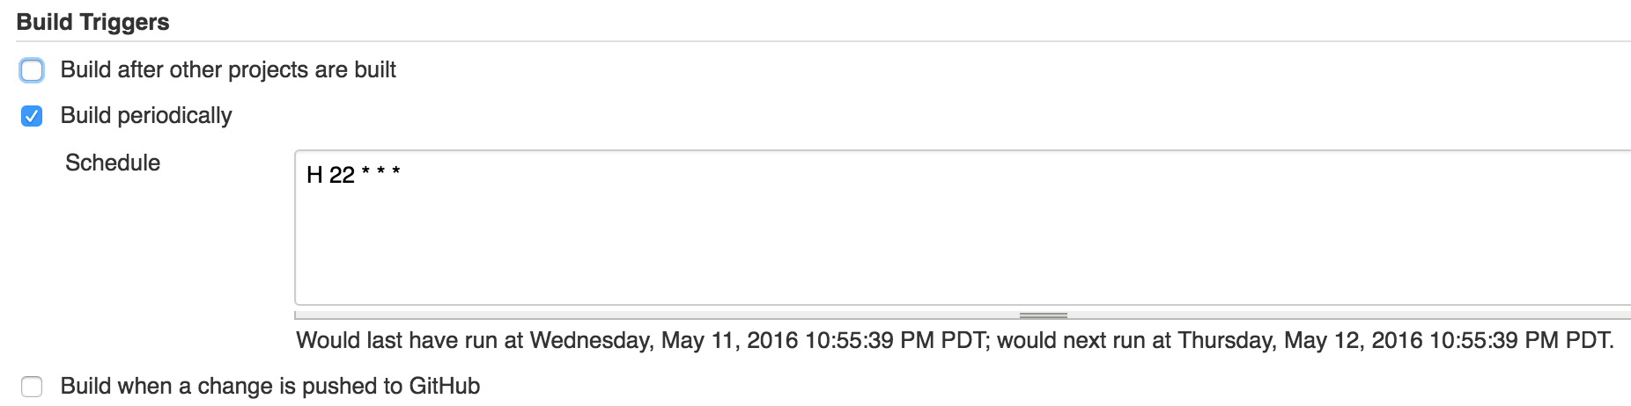
Configure Jenkins Build Triggers

Slide 11
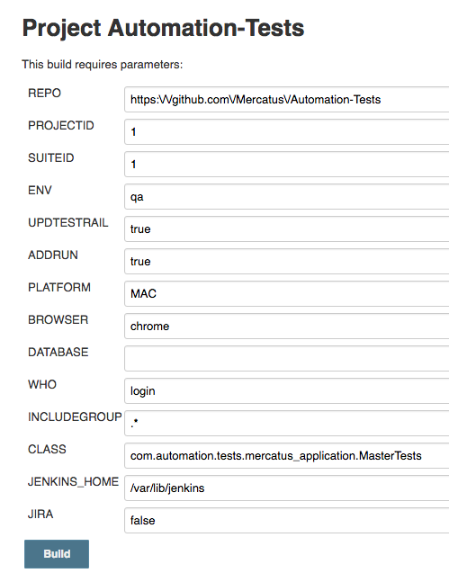
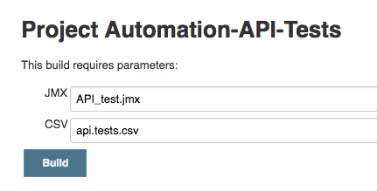
Jenkins parameterized build

Slide 12
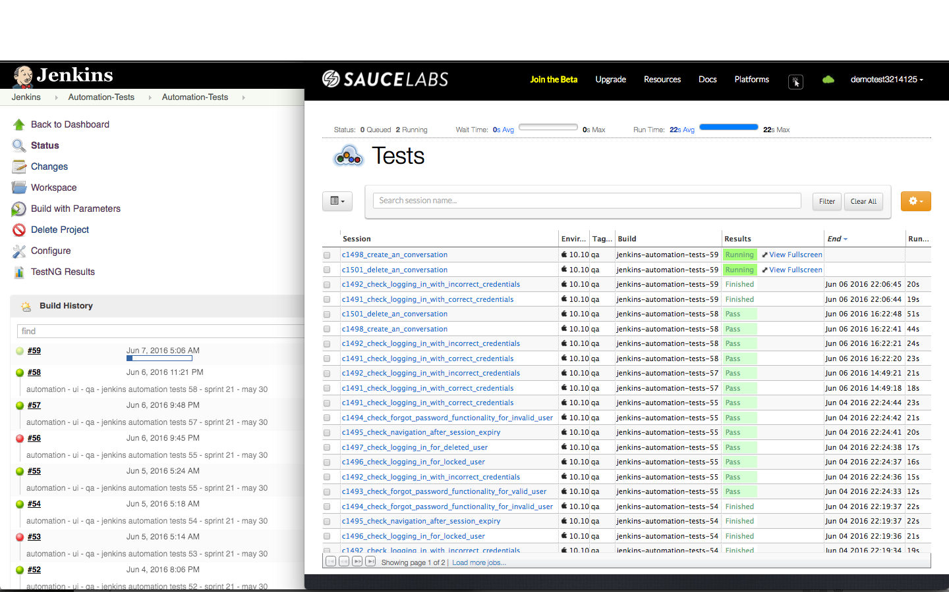
Jenkins + Sauce Labs
Notes:
adsfasd

Slide 13
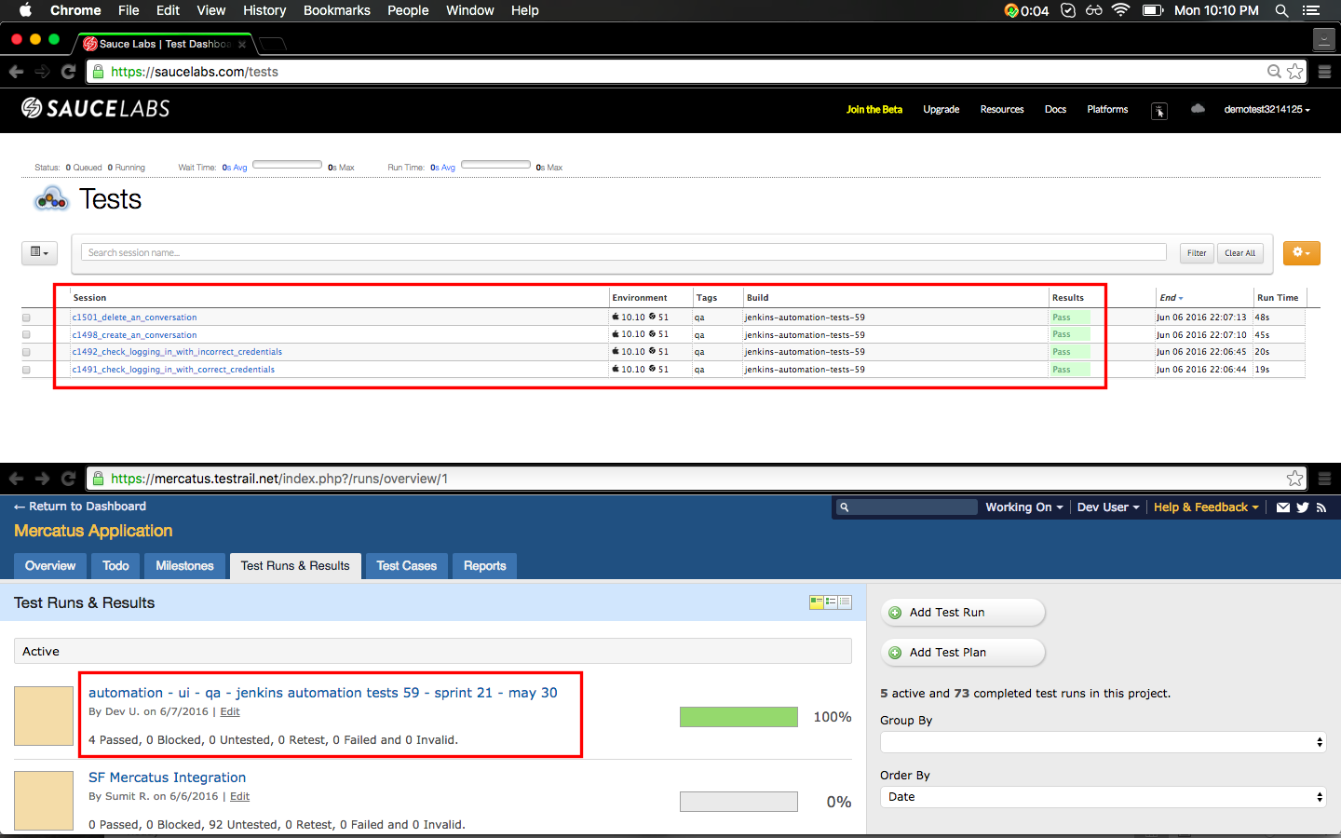
Sauce Labs + Test Rail

Slide 14
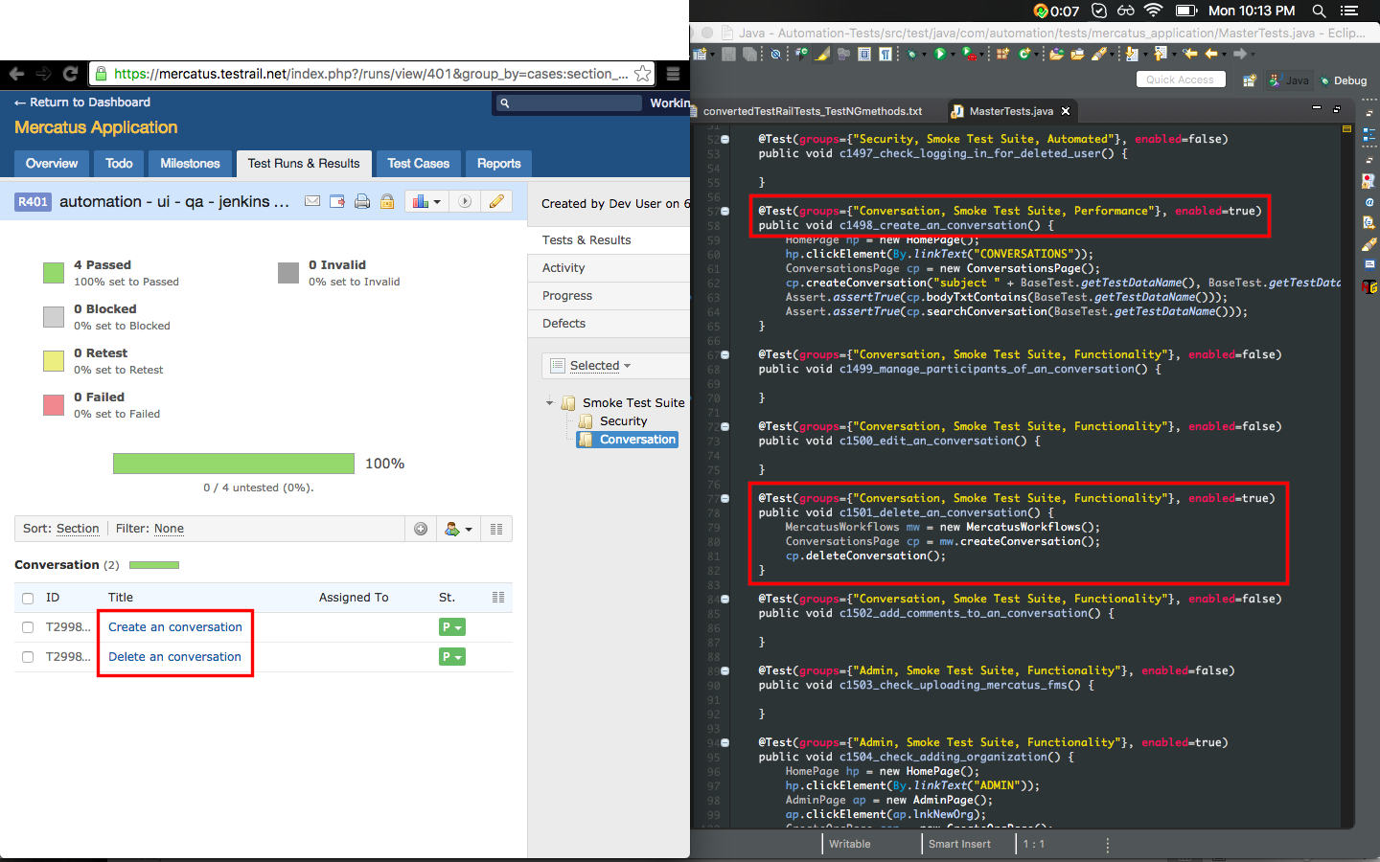
Test Run only contains enabled tests

Slide 15
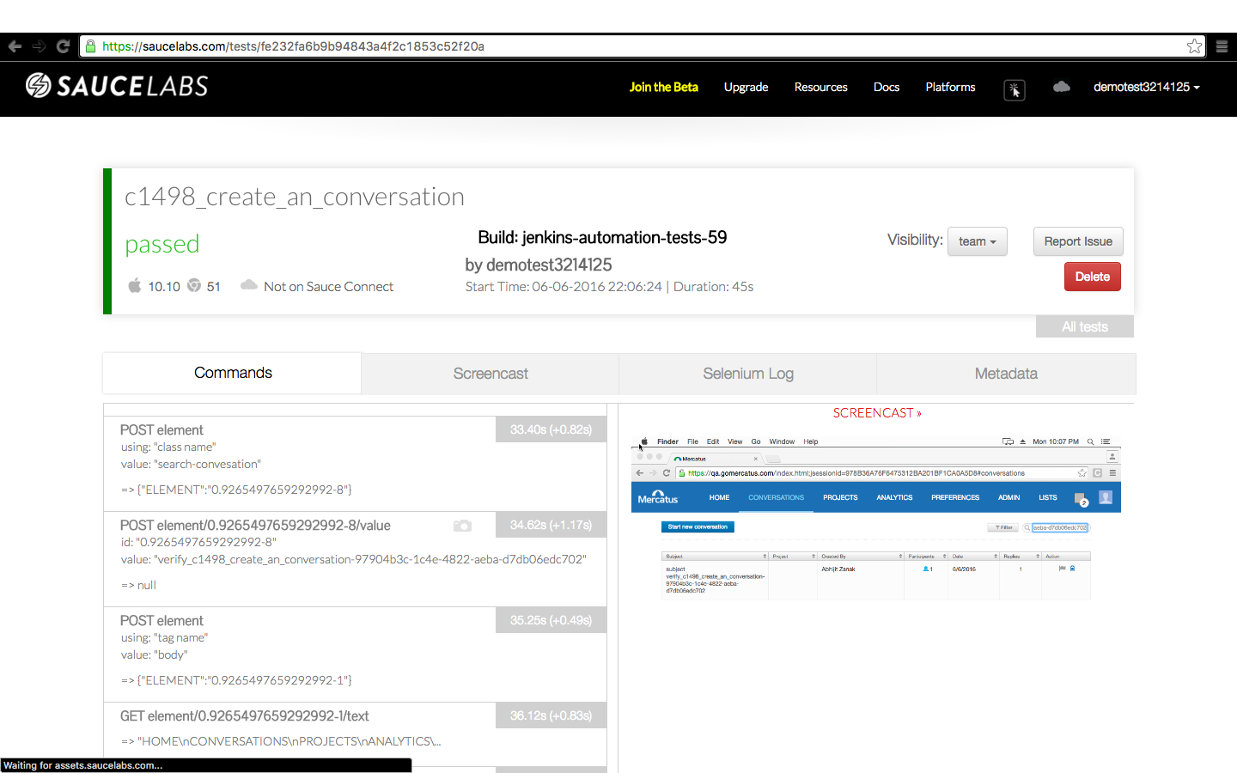
Screenshots

Slide 16
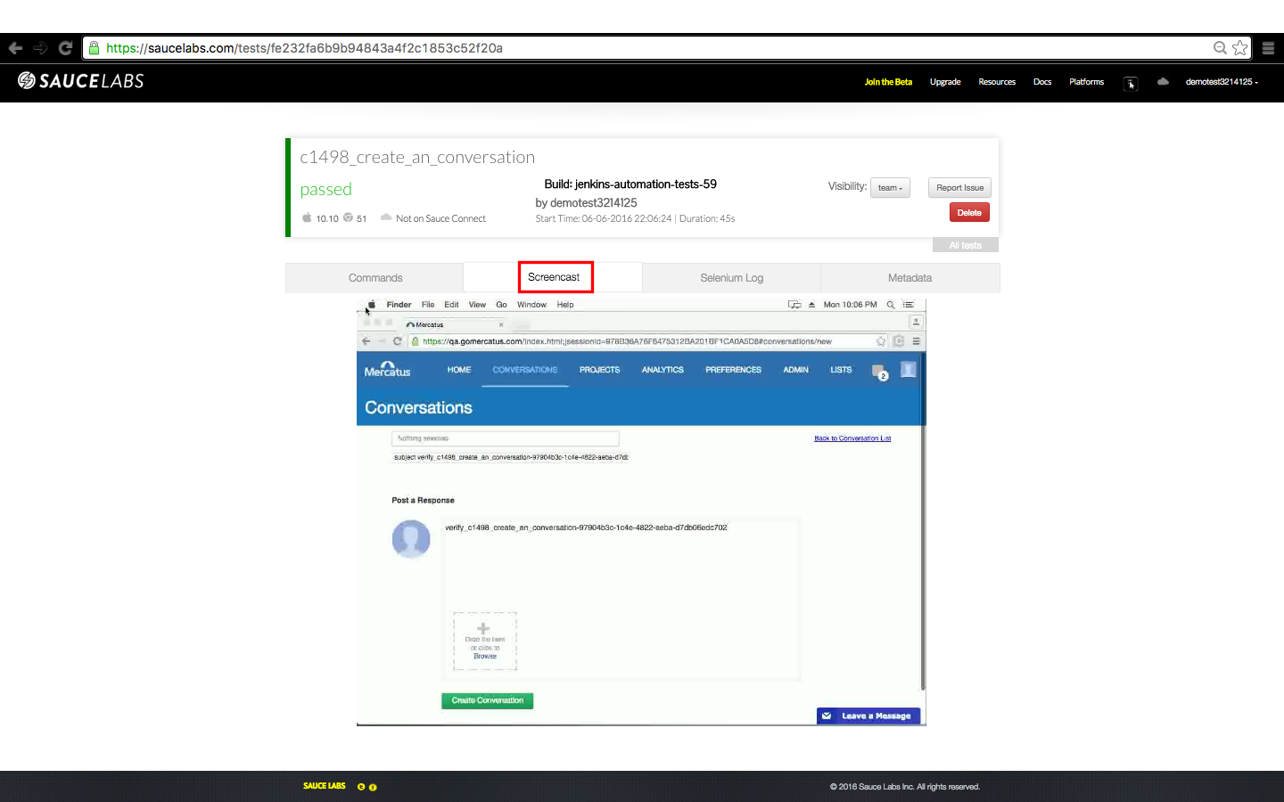
Screencast

Slide 17
Real-time messaging during test run

Slide 18
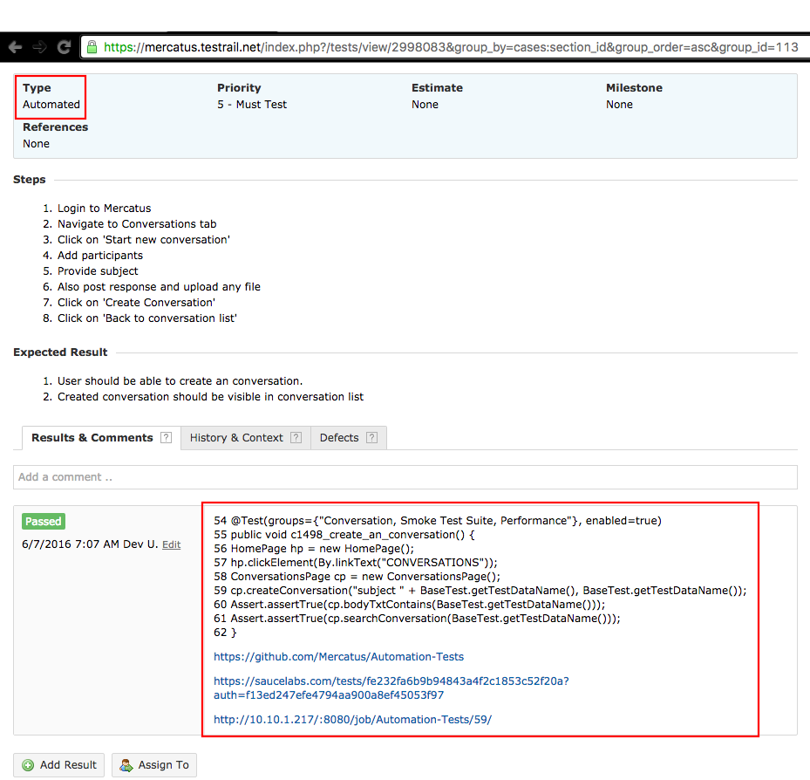
TestRail results

Slide 19
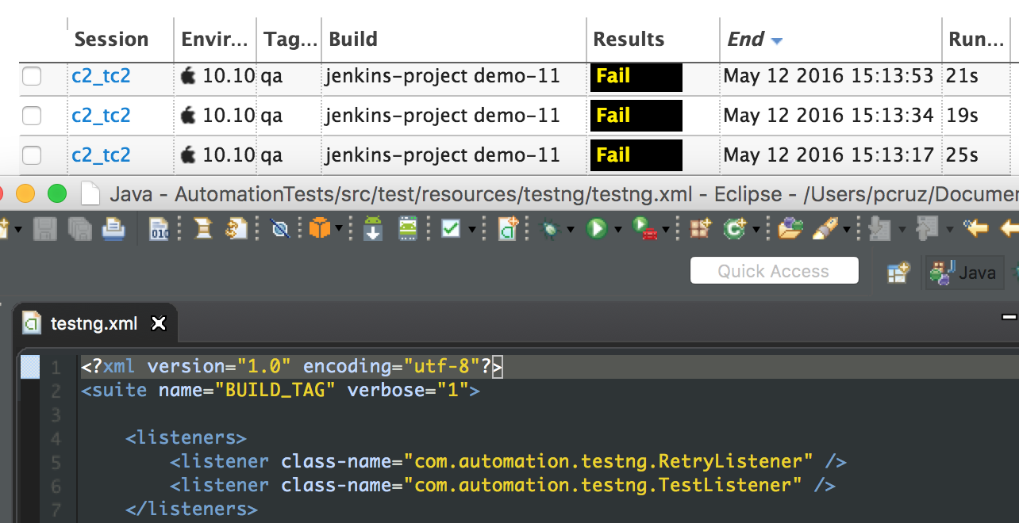
Retry failed tests

Slide 20
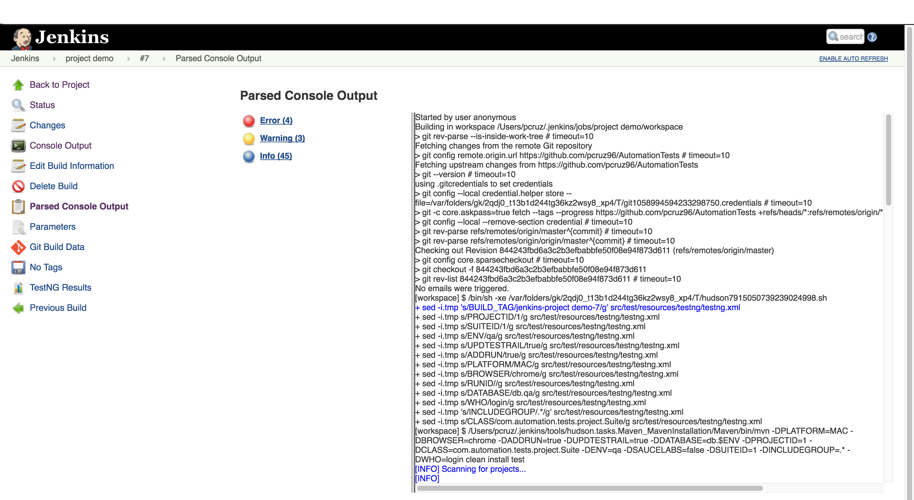
Parsed Console Output for Jenkins build

Slide 21
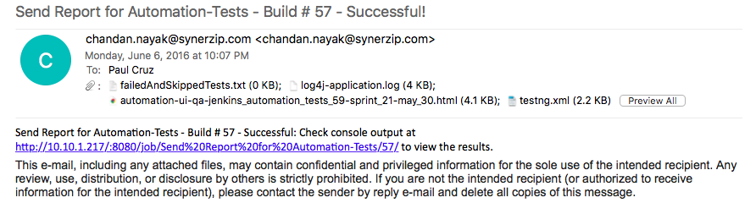
Post-build emails

Slide 22
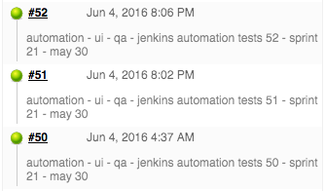
Jenkins Build description

Slide 23
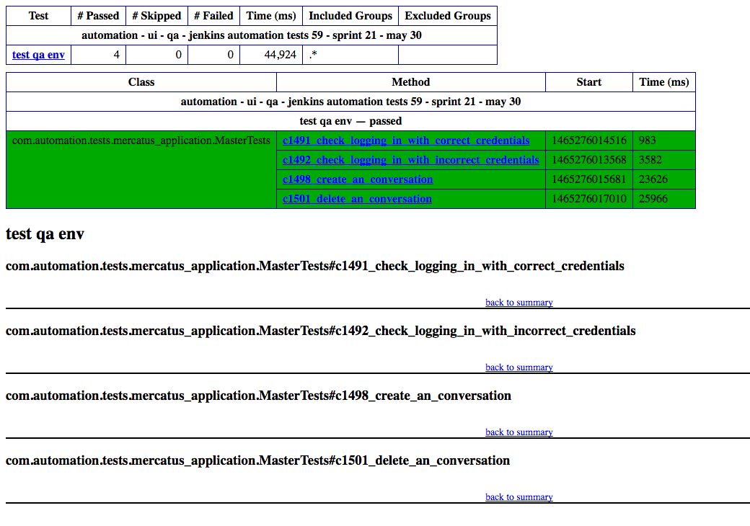
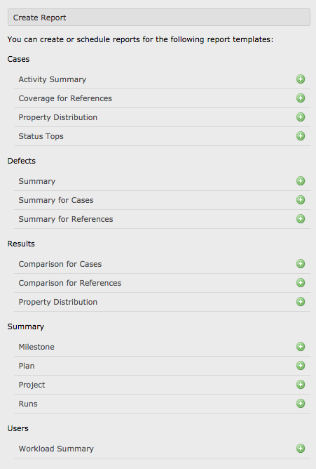
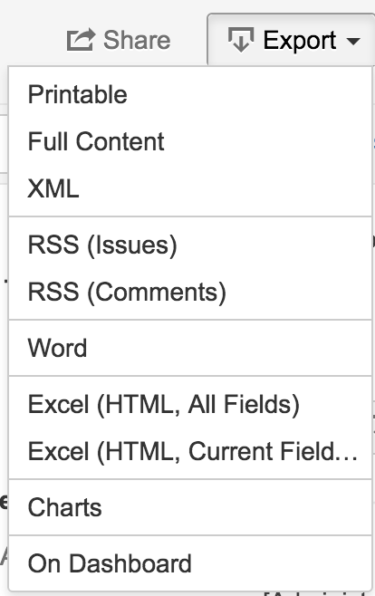
Built-in Reports
TestNG emailable-report.html TestRail
Jira

Slide 24
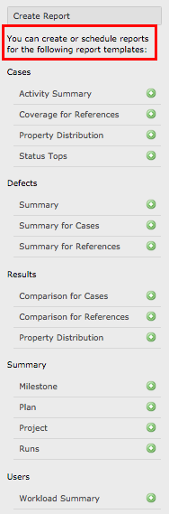
Schedule various report templates

Slide 25
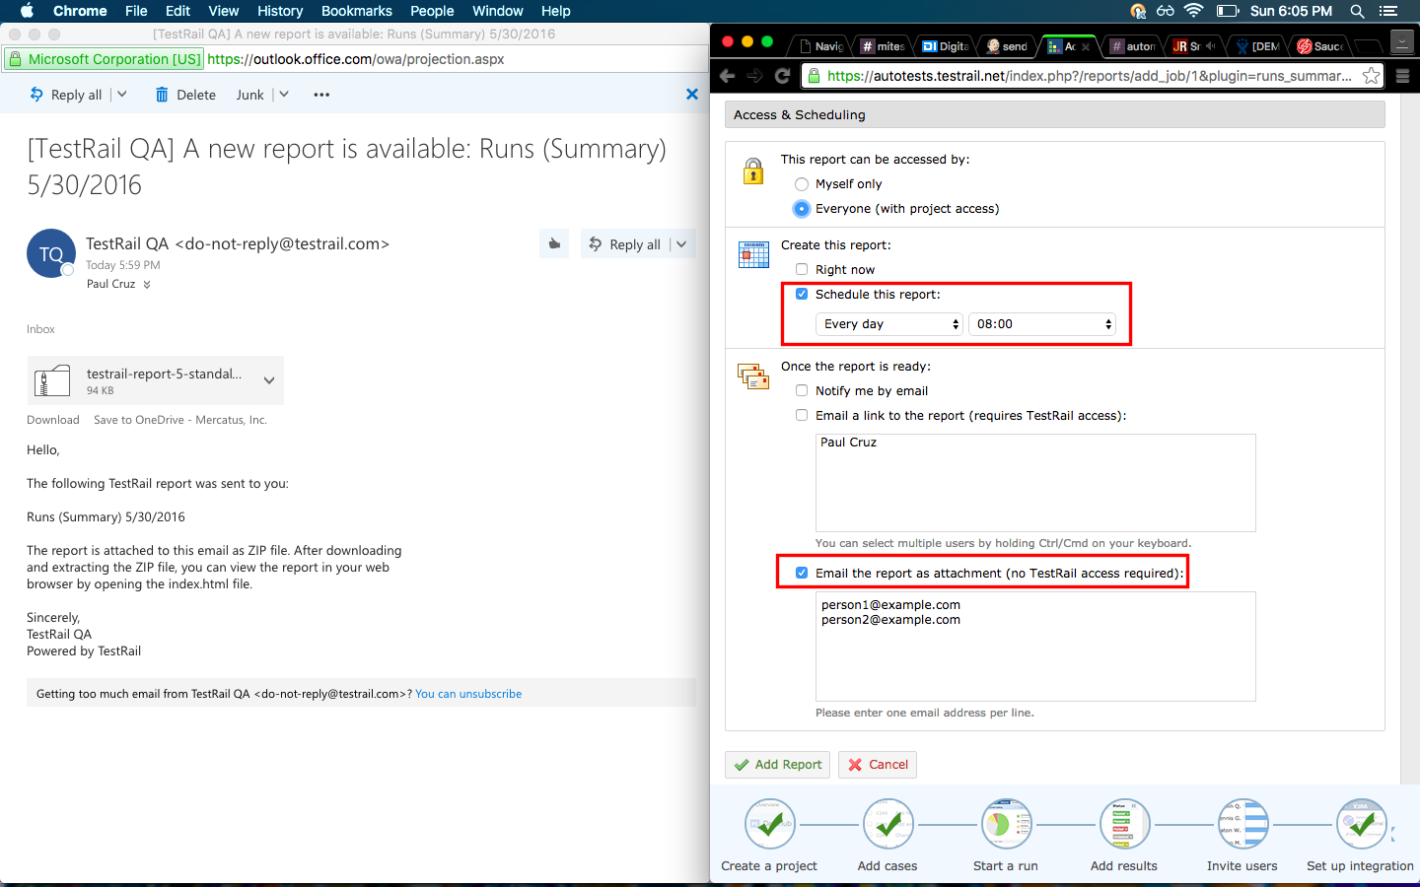
TestRail reports

Slide 26
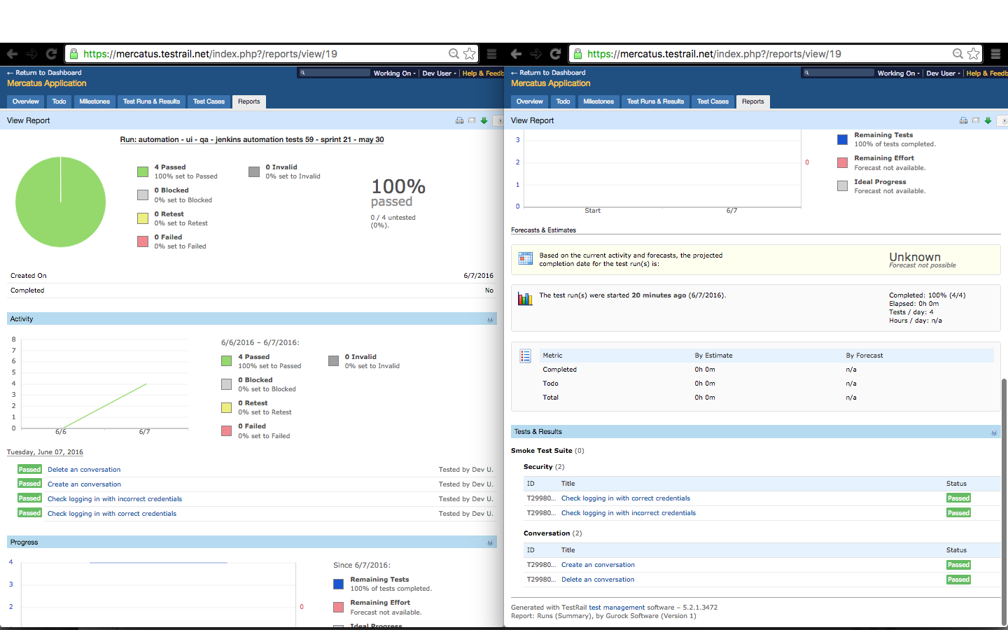
Sample report

Slide 27
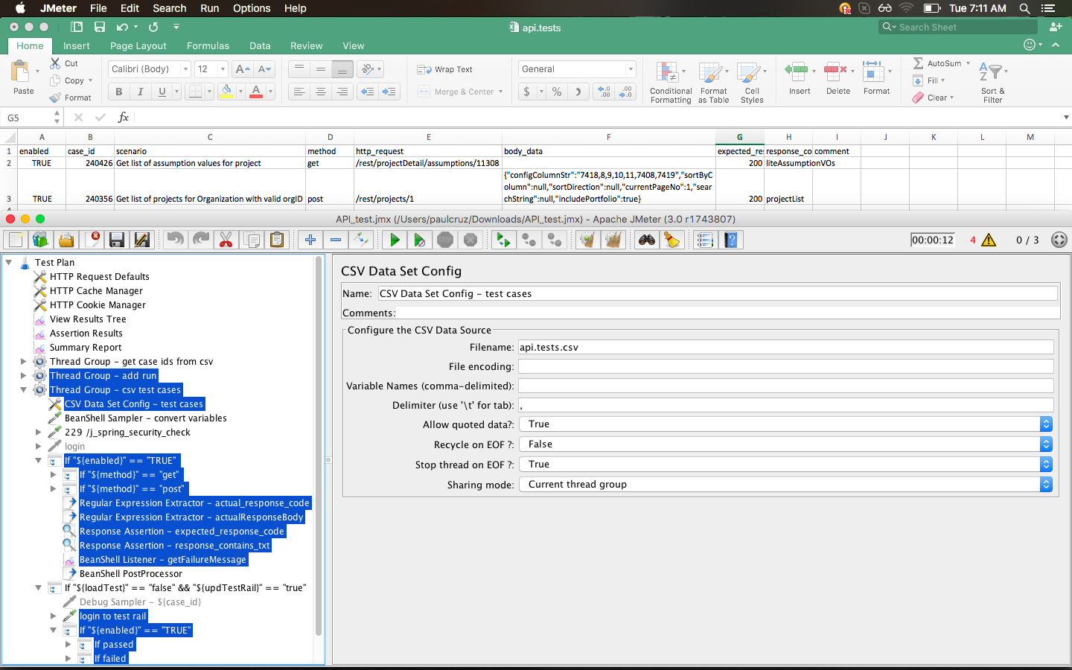
Jmeter + CSV

Slide 28
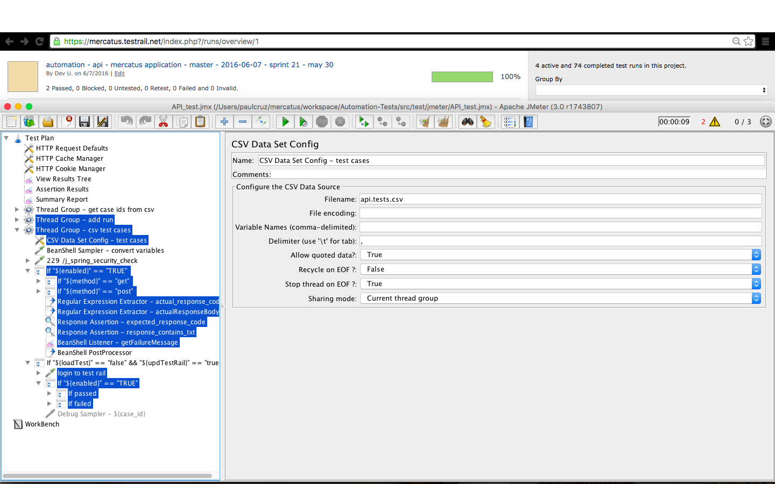
JMeter + TestRail

Slide 29
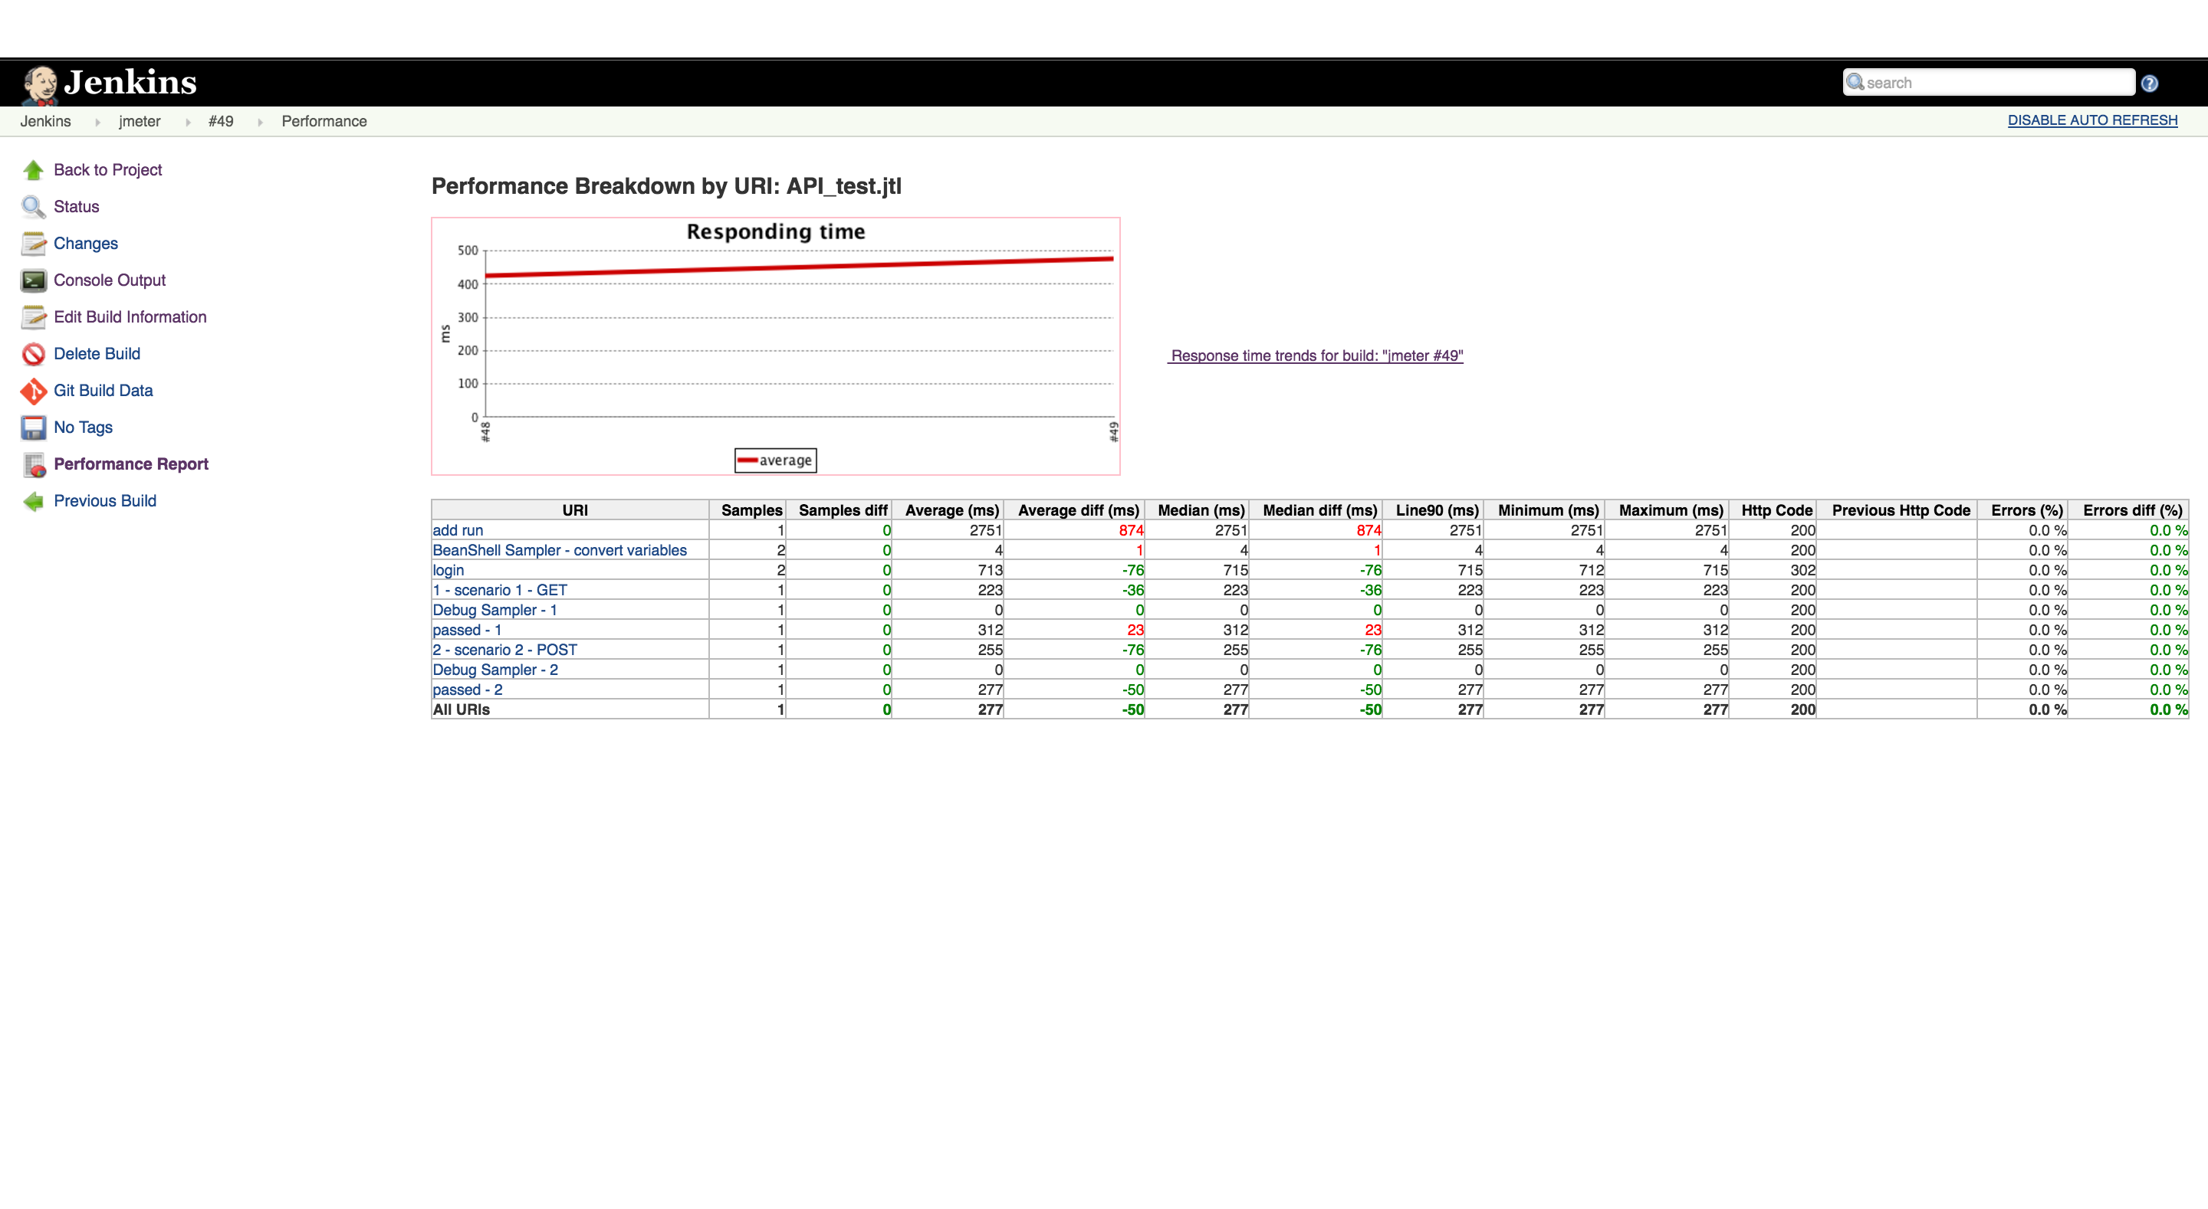
Jenkins + JMeter

Slide 30
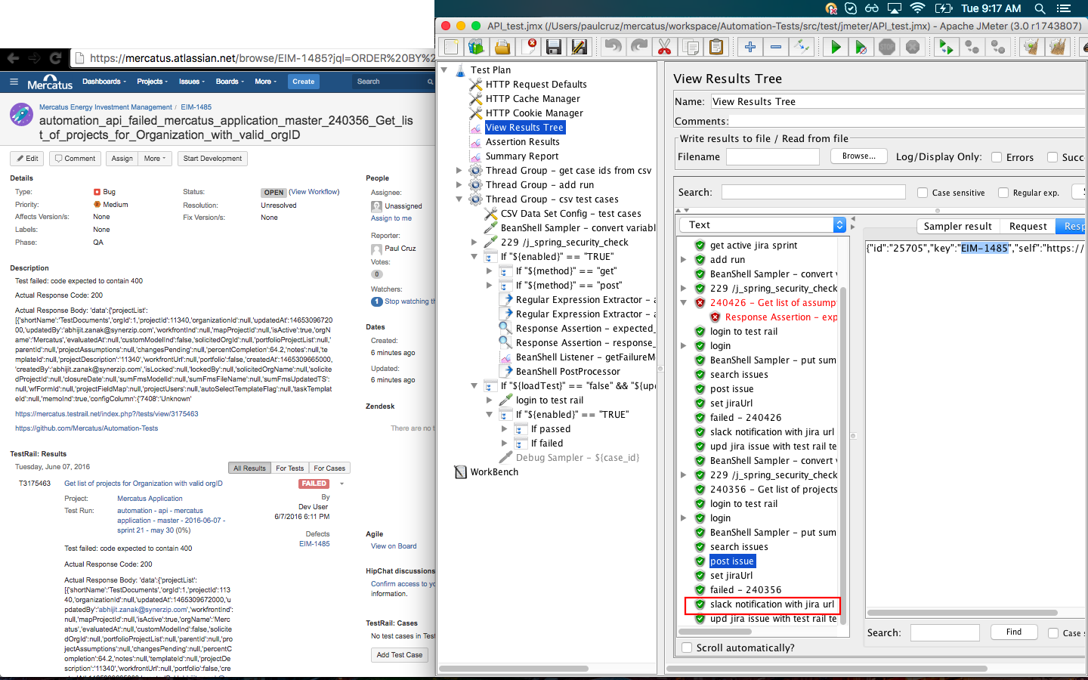
JMeter + Jira + TestRail + Slack

Slide 31
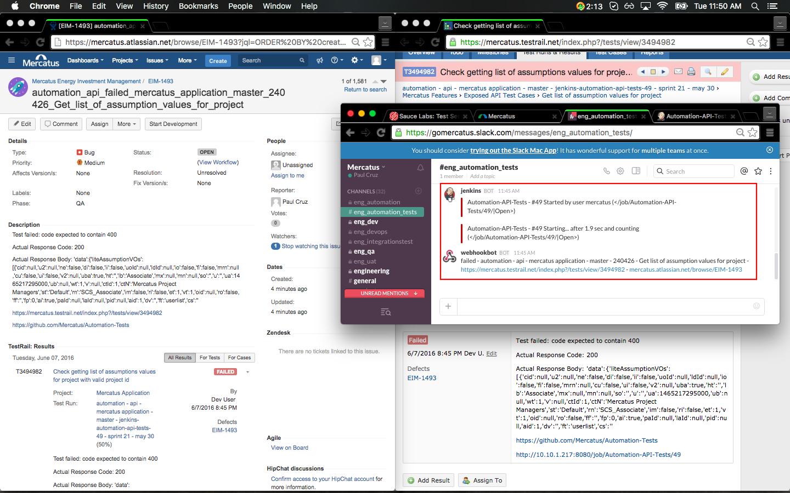
Jenkins + JMeter + TestRail + Slack

Slide 32
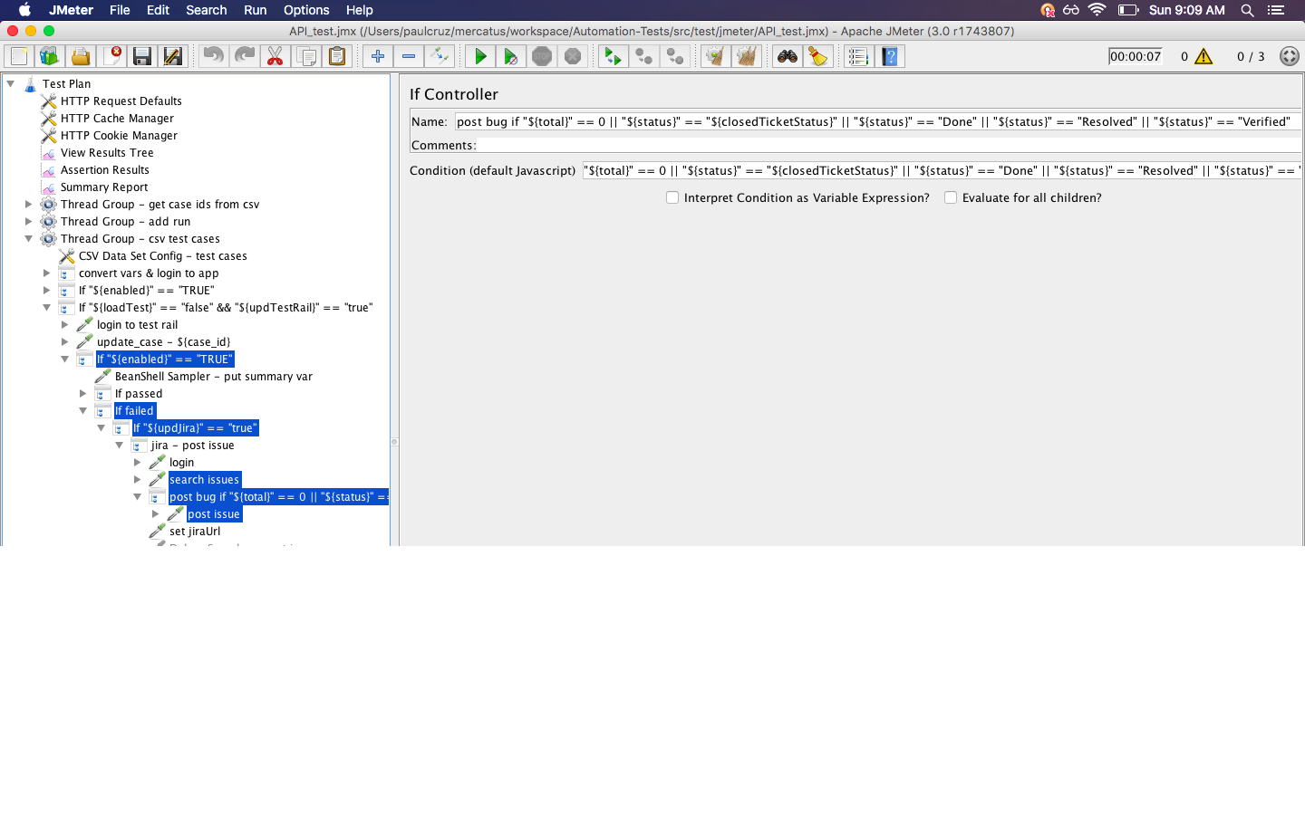
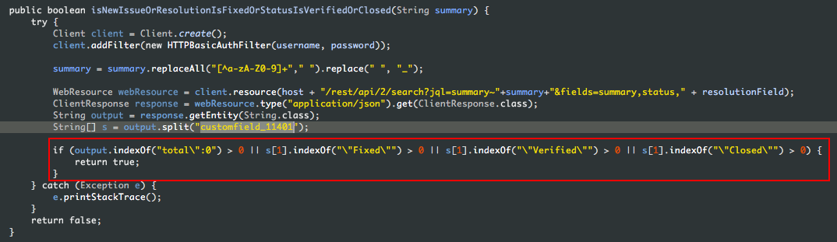
Post Jira bug if…

Slide 33
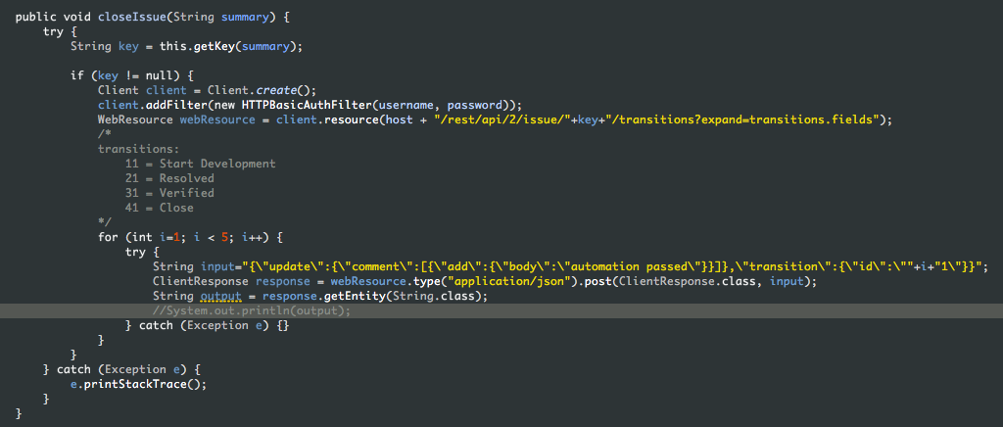
Close Jira bug if UI test passed

Slide 34
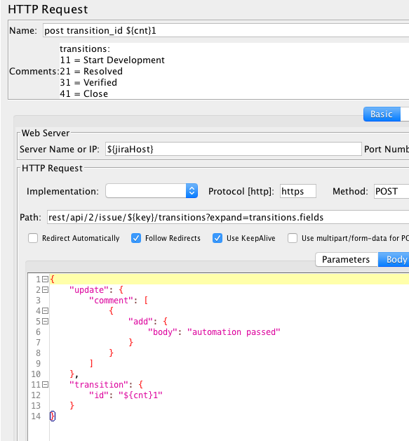
Close Jira bug if API test passed

Slide 35
Q & A Thank you!

